Slide 1
Introduction to R
Shamelessly adapted from
Navarro’s Statistics in R

Slide 2
First Notes:
You can learn R.
You will get frustrated.
You will get errors that don’t help or make sense.

Slide 3
First Notes:
Google is your friend.
Try googling the specific error message first.
Not the NaN one though, because ugh.
Then try googling your specific function and the error.
Try a bunch of different search terms.

Slide 4
First Notes:
Helpful websites:
Quick-R: www.statmethods.net
R documentation: www.rdocumentation.org
TryR: tryr.codeschool.com
Swirl: www.swirlstats.com
Stack Overflow: www.stackoverflow.com

Slide 5
First Notes:
Helpful text (for statistics):
Andy Field’s Discovering Statistics in R
Daniel Navarro Learning Statistics in R
This book is free online!

Slide 6
What is R?
R is a statistical programming language
You may have used SPSS
SPSS = $$$, R = free!
SPSS = very limiting on how you can do an analysis, R = which one of 100 ways can I do something?
R is the future!

Slide 7
Get R
Download R from a CRAN mirror
http://cran.r-project.org/
Note:
Mac users will also need Quartz for plotting

Slide 8
Get RStudio
For the love of sanity RStudio:
http://www.rstudio.org/
RStudio is a graphical overlay for R that helps you understand what you are doing
It opens R for you, so you just open studio to get started.

Slide 9
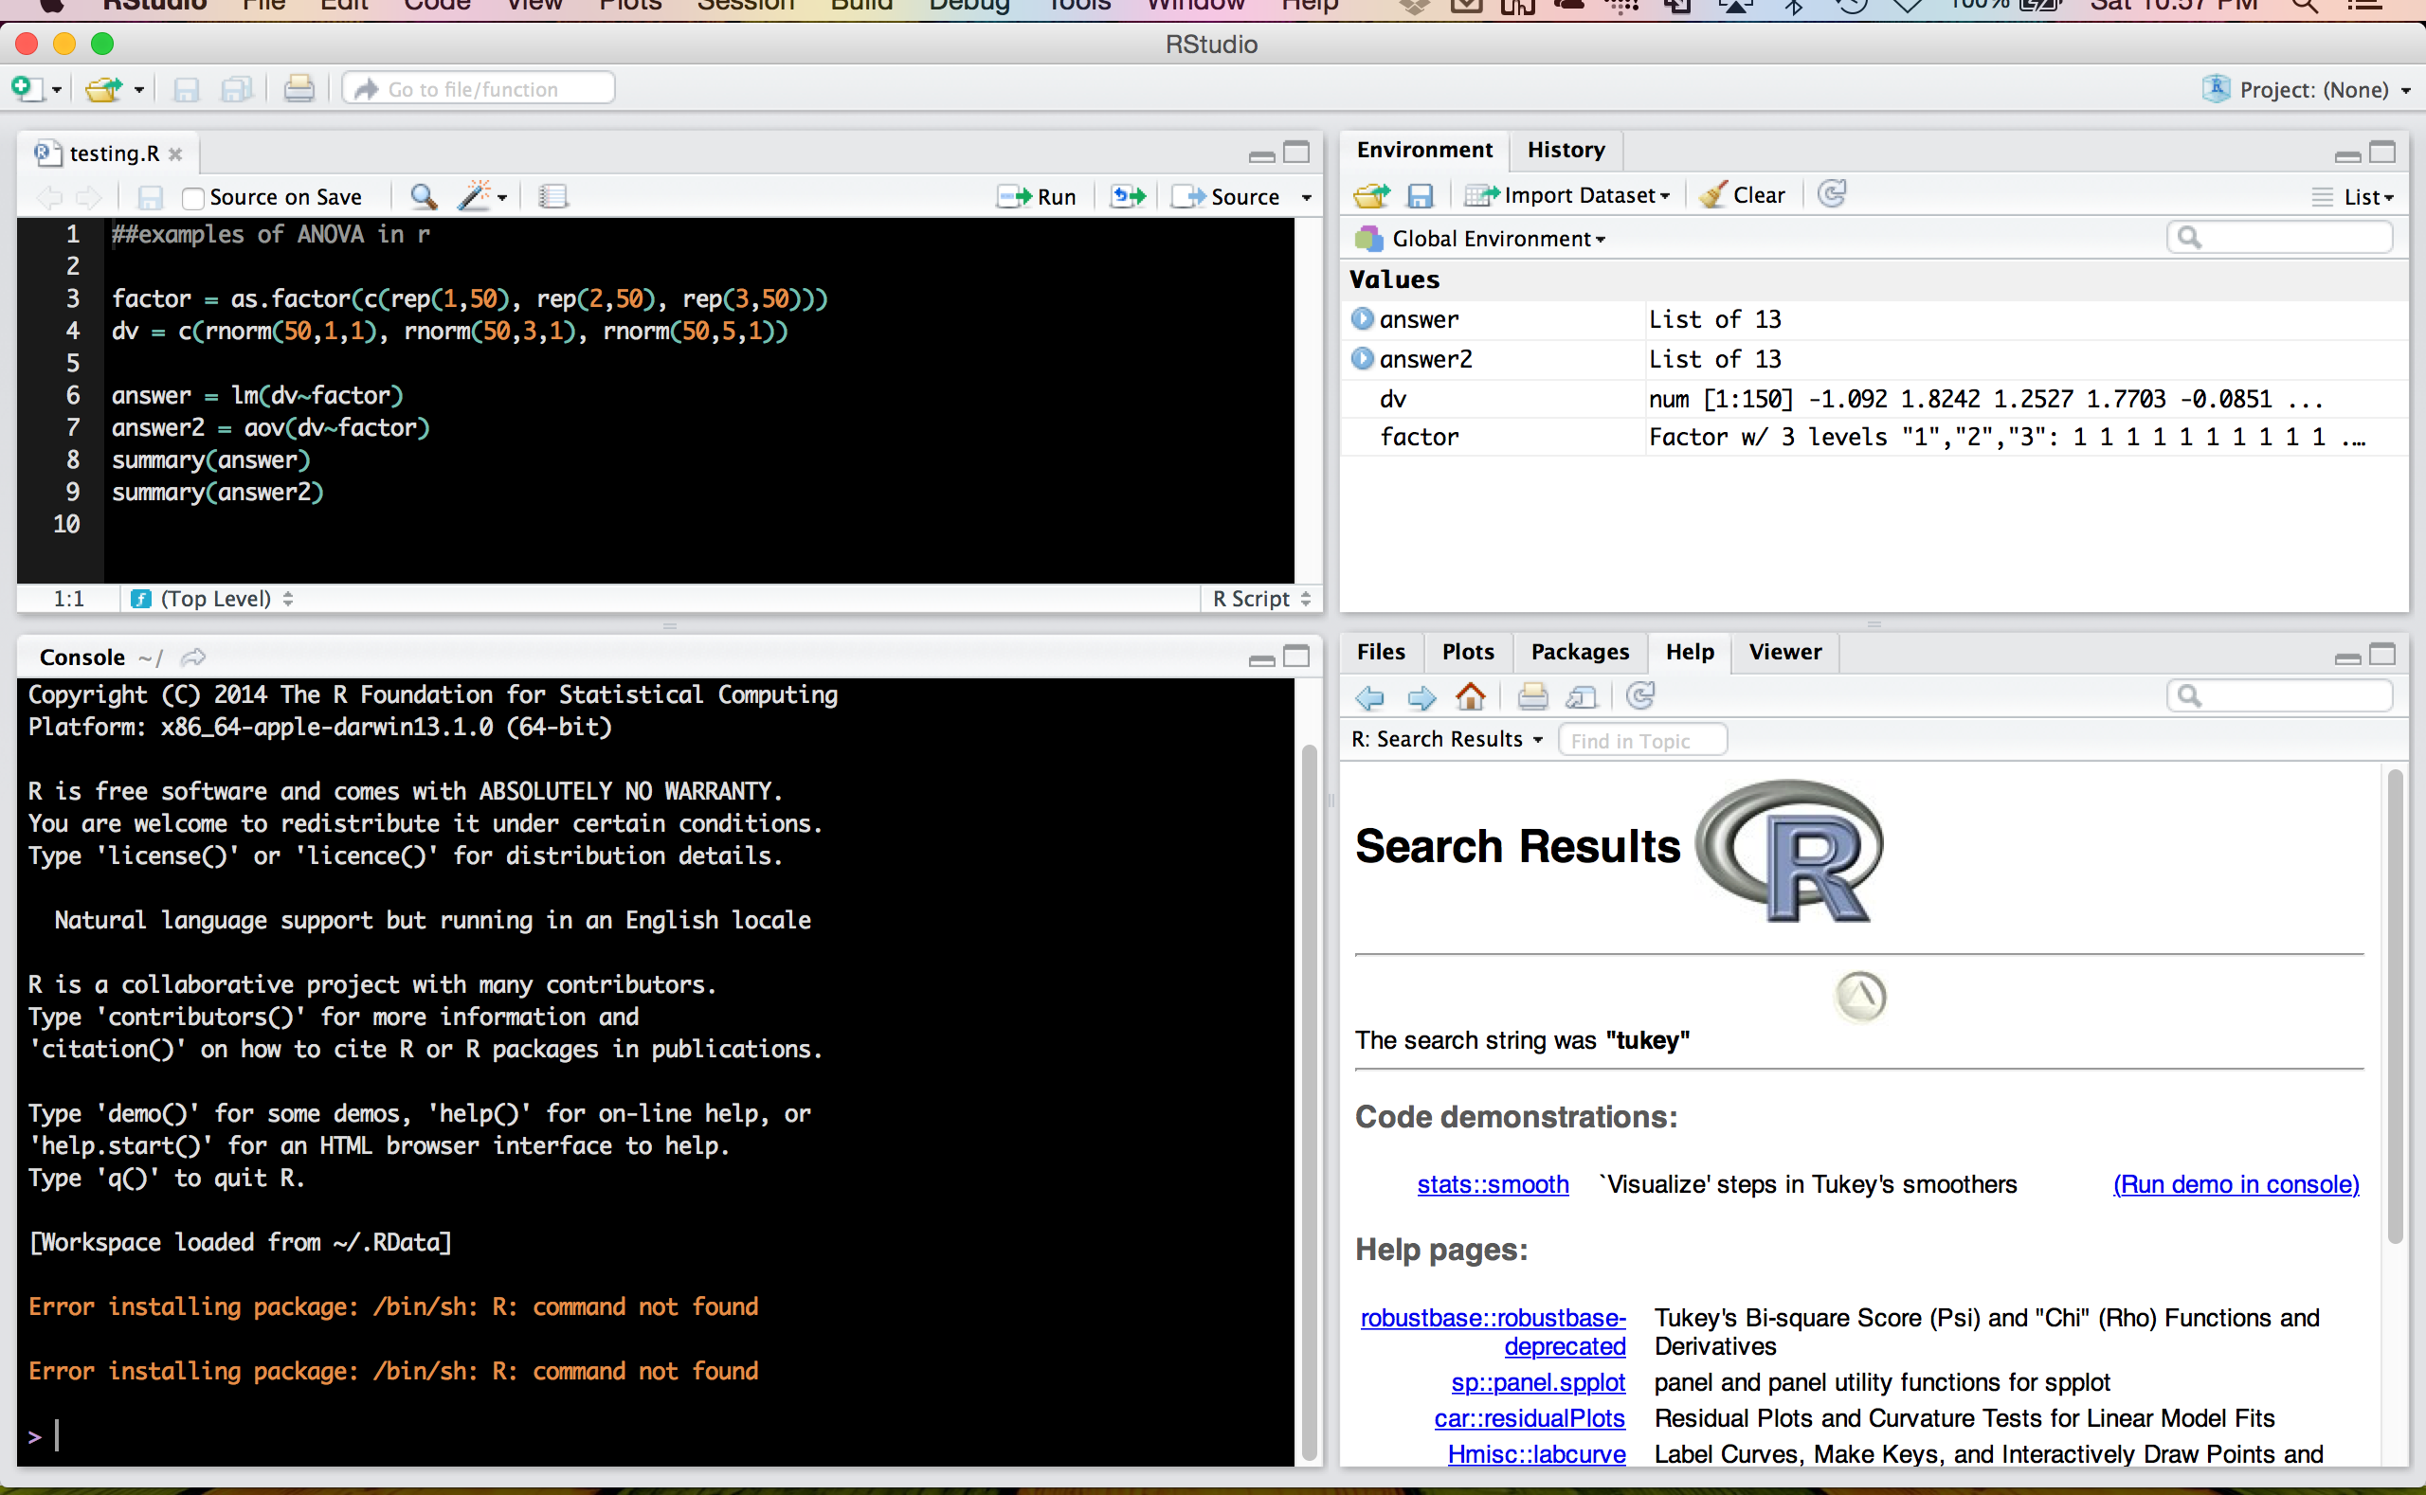
Screen shot of RStudio

Slide 10
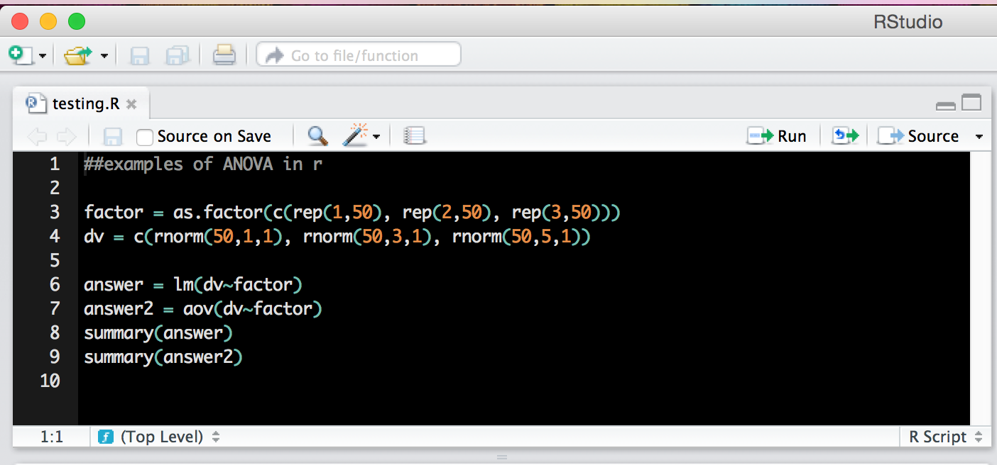
Top left window
Scripting window – these files end with .R extension.

Slide 11
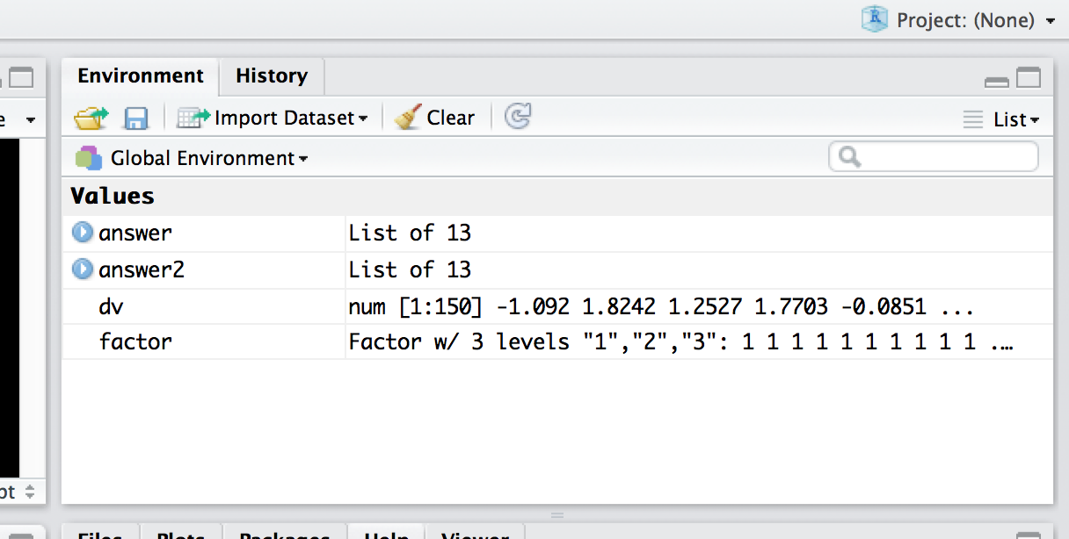
Top right window
Environment window – you can save the environment (variables, scripts, console) as
.Rdata files.

Slide 12
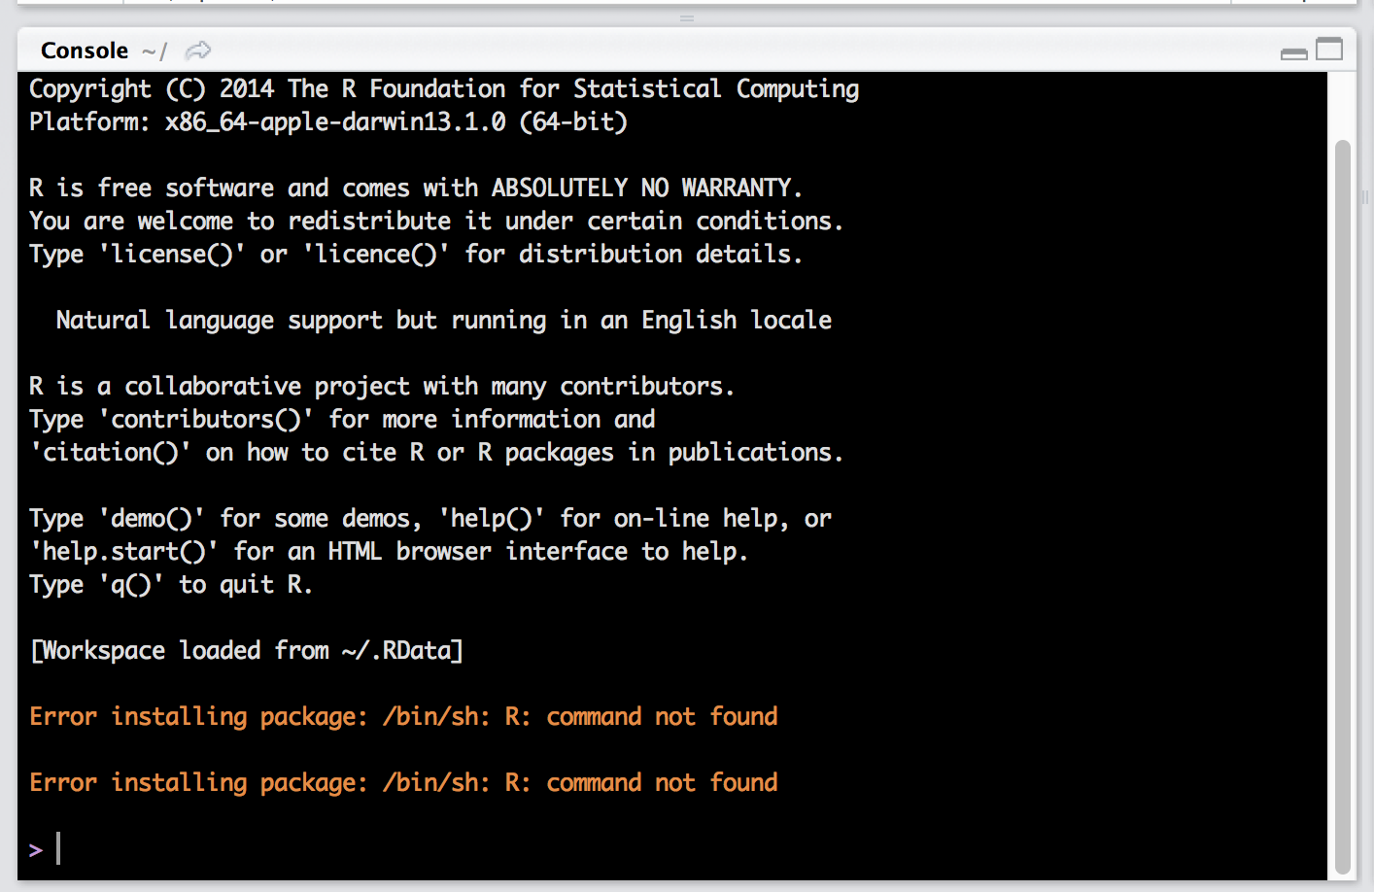
Bottom left window
The console – where all the magic happens

Slide 13
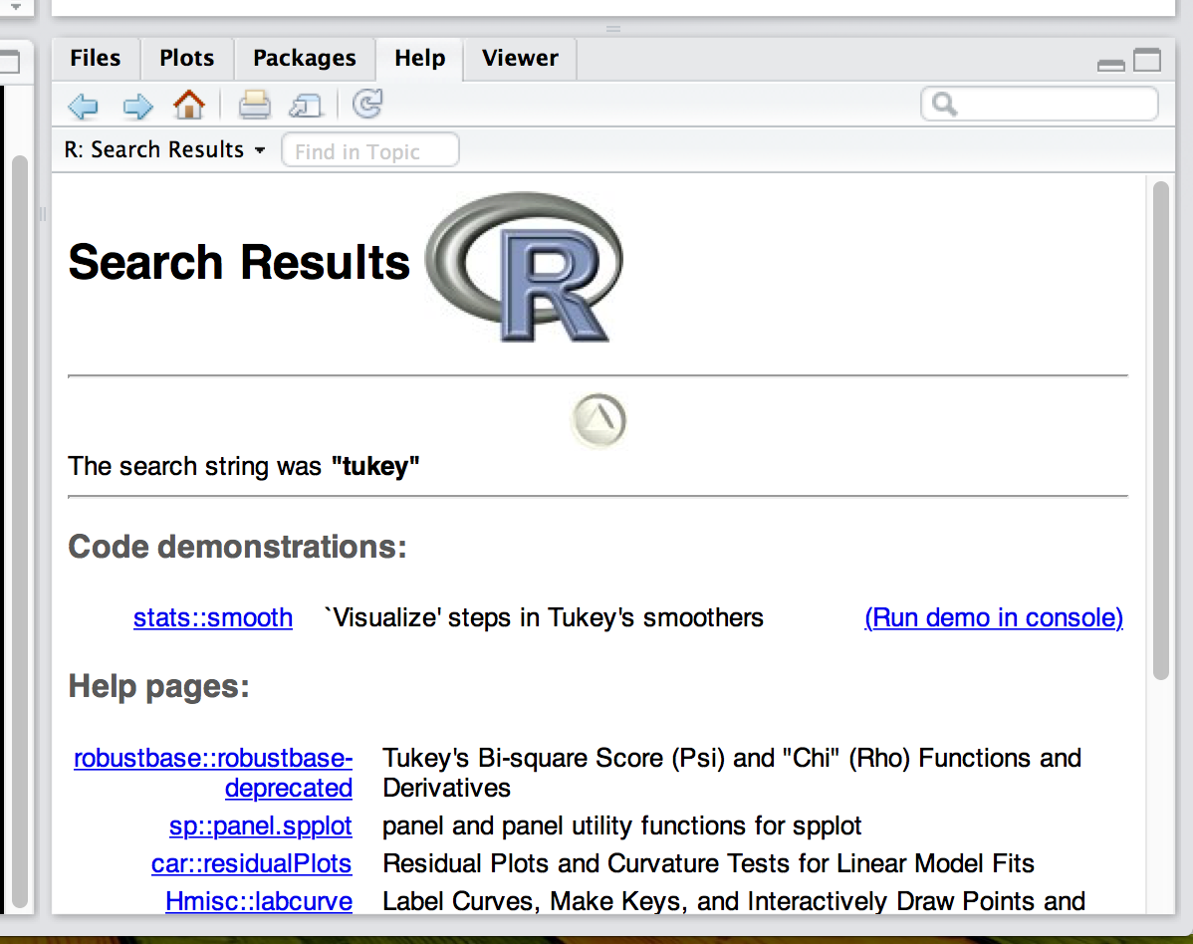
Bottom right window
The help area, plots, files

Slide 14
Commands
Commands are the code that you tell R to do for you.
They can be very simple.
They can be very complex.
A note: R only does what you tell it. So when you encounter a mistake, it may be a typo or it may be an error in what you coded.

Slide 15
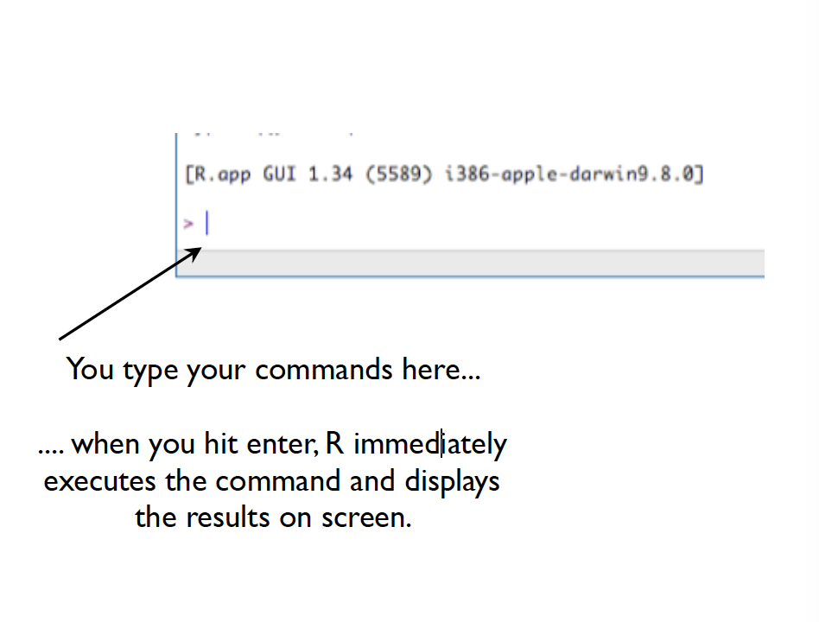
Commands
Use the bottom LEFT window in studio – called the console.

Slide 16
Commands
The > is the command prompt
That means that R is waiting for instructions from you.
If you see a + that means you still need to give R information for it to run your command.
If you hit ESC (escape) you can clear out a + if you can’t figure out what is wrong.

Slide 17
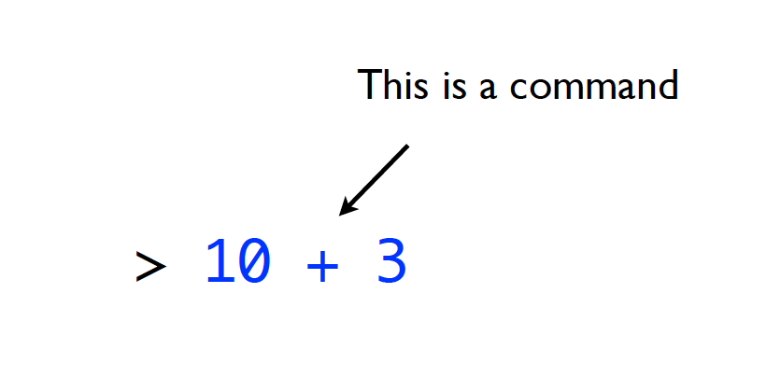
Commands

Slide 18
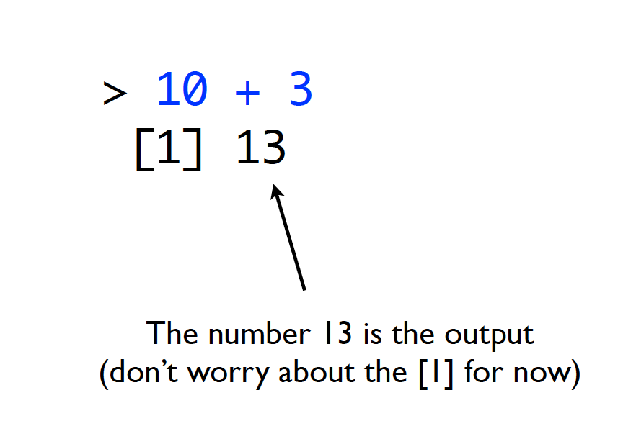
Commands

Slide 19
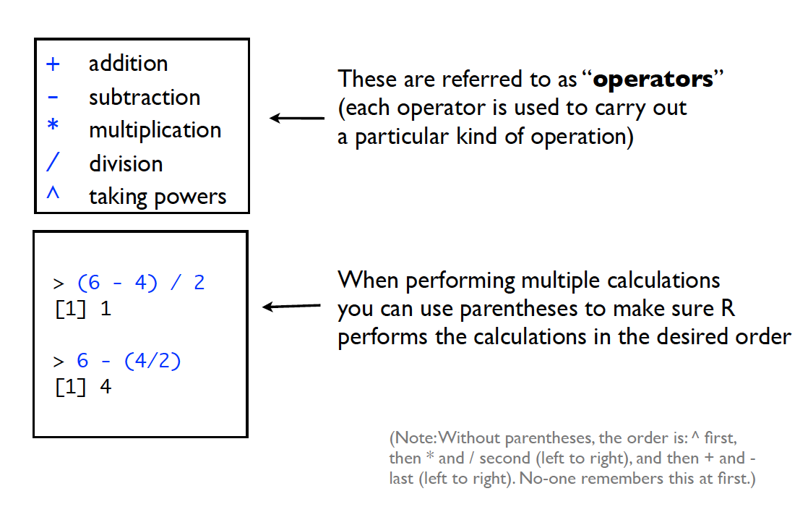
Commands

Slide 20
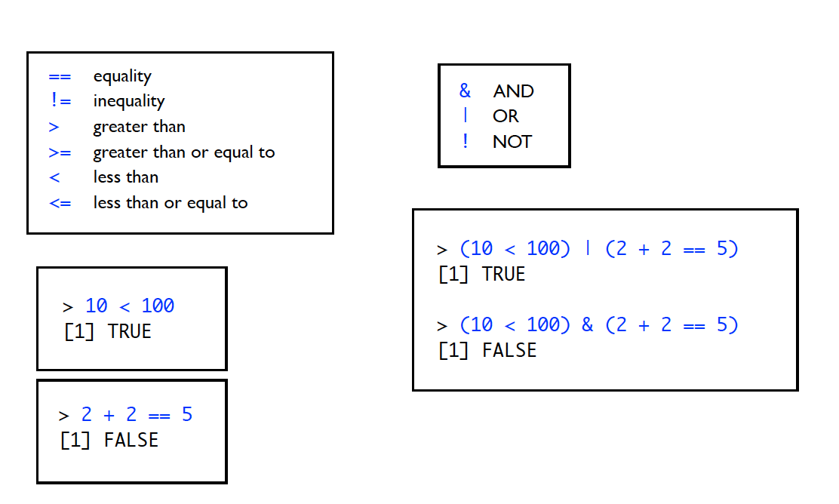
Logical Commands

Slide 21
Logical Commands
Logical commands allow you to determine if something is true or false
Why is this useful?
You can use to select data you are interested in working with or discarding.

Slide 22
Commands
Note:
= and <- are equivalent (more on this later).
I always use = signs NOT to be confused with logical ==.

Slide 23
Commands
Two console shortcuts:
Hit the up arrow – you can scroll through the last commands that were run.
Hit the tab key – you’ll get a list of variable names and options to select from.

Slide 24
Scripts
What is an R script?
R scripts are text files, and they have .R extension.
They contain a sequence of R commands that R will execute with the script is run.

Slide 25
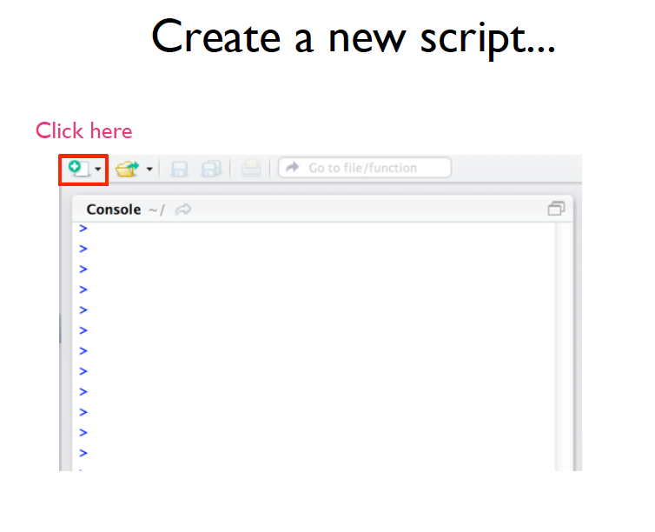
Scripts

Slide 26
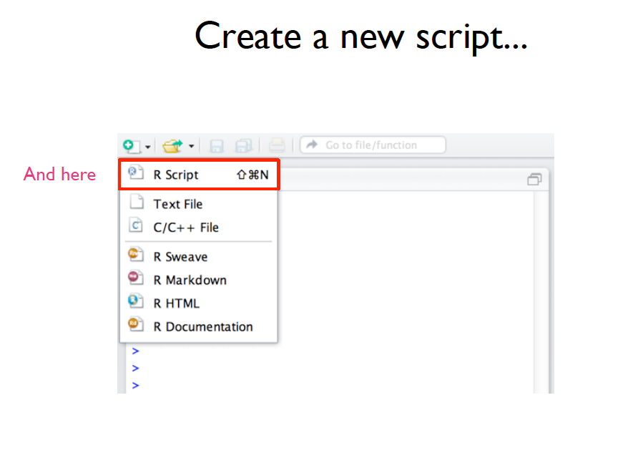
Scripts

Slide 27
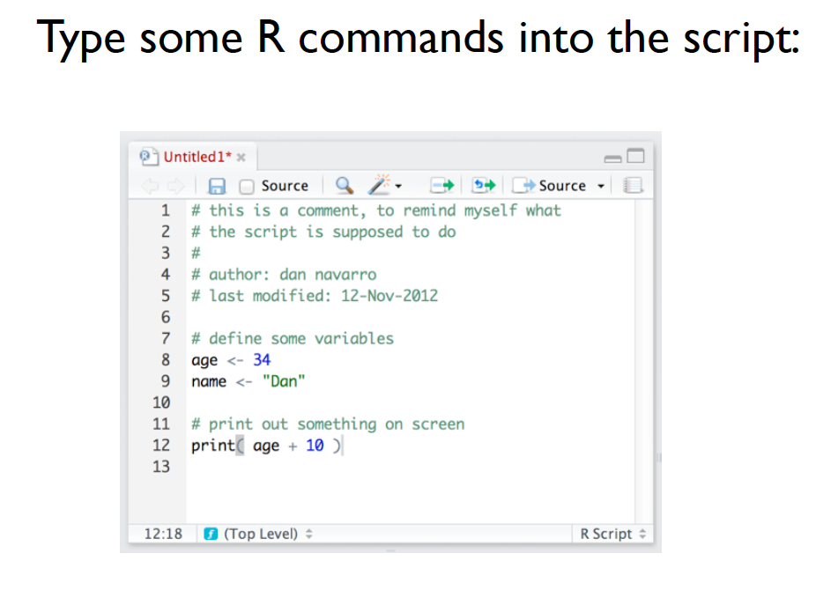
Scripts

Slide 28
Scripts
You should notice that nothing happened in the console.
The script window allows you to work on/save code without running it.

Slide 29
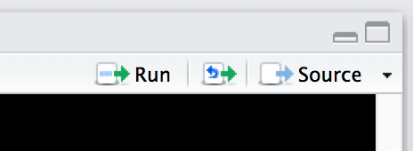
Scripts
You can run the code by highlighting it and clicking on run or by hitting:
Windows: ctrl + r or ctrl + enter
Mac: command (apple) + return

Slide 30
Scripts
The script window is great for saving projects so you can remember and recreate your steps when you need to later.

Slide 31
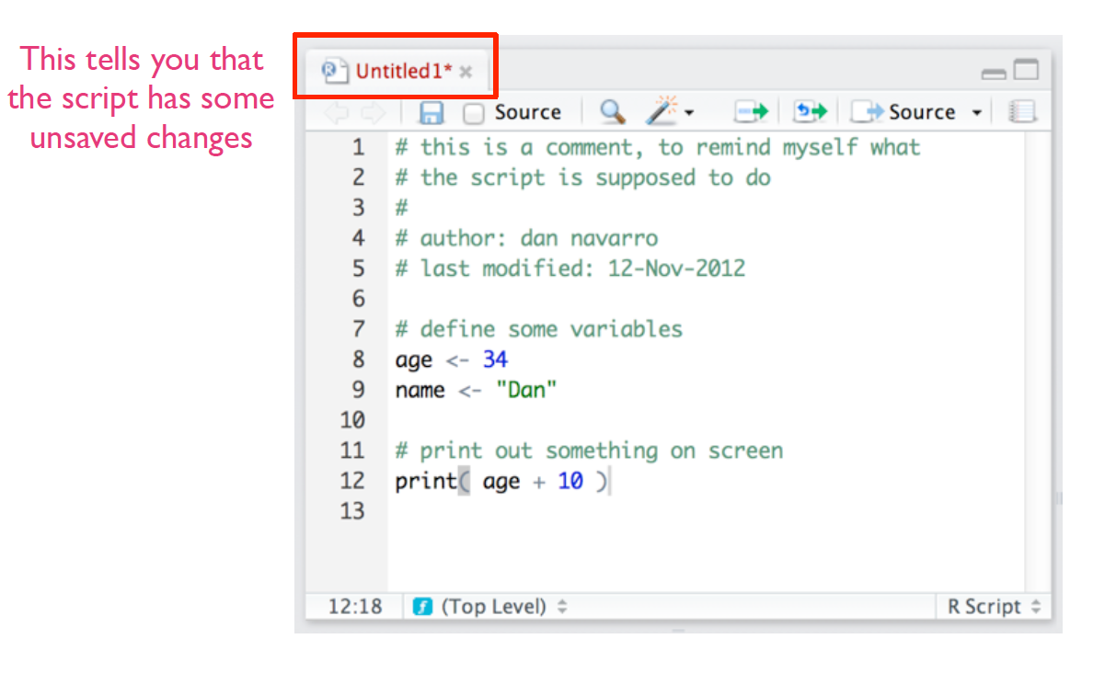
Scripts

Slide 32
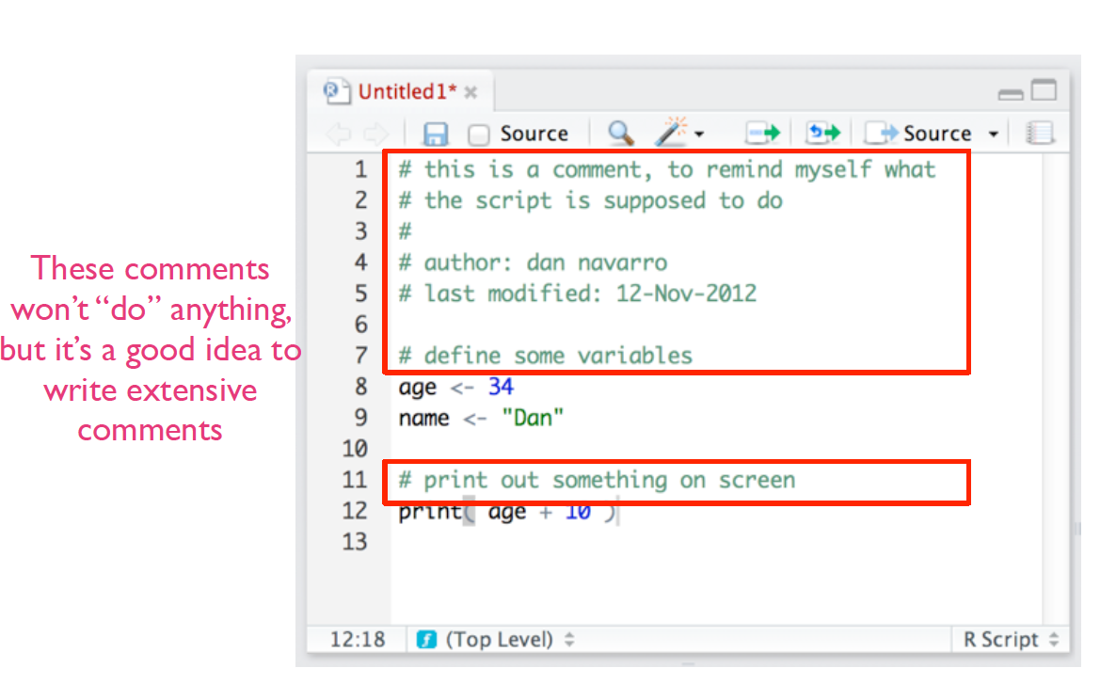
Scripts

Slide 33
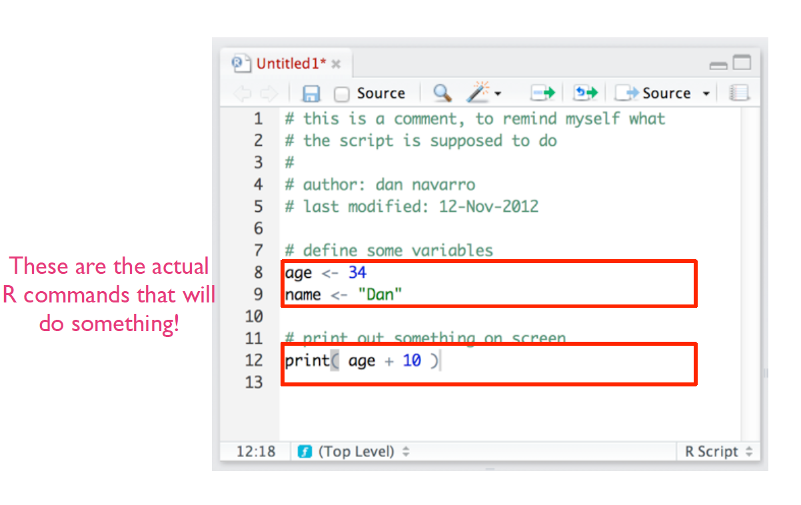
Scripts

Slide 34
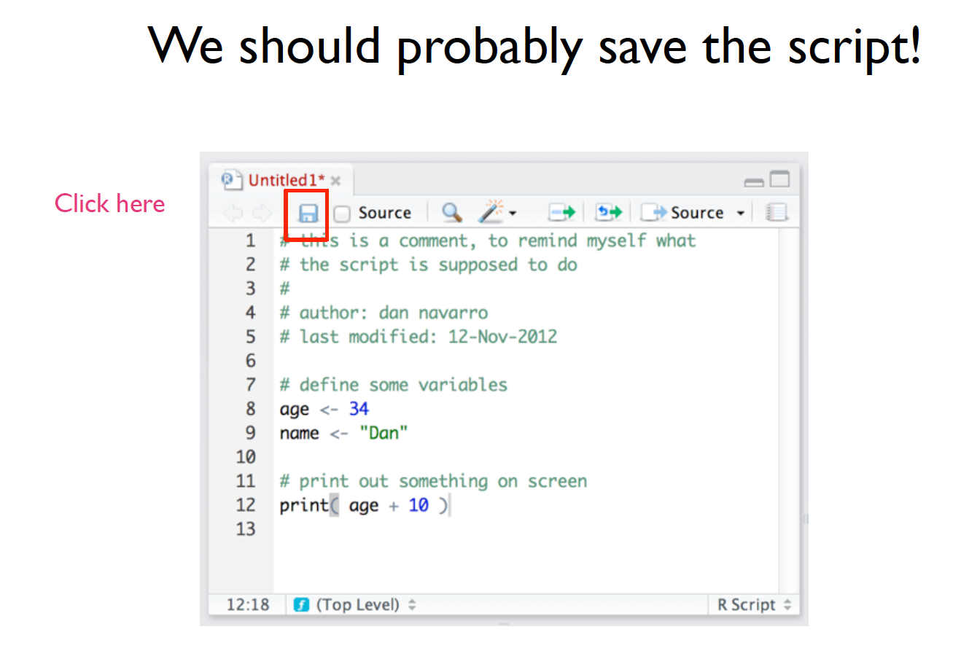
Scripts

Slide 35
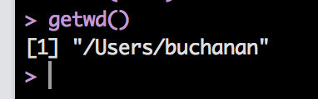
Working Directory
The working directory is where you are currently saving things in R.
What is the current working directory?
Type in getwd()
You’ll see the path for your directory
Note: I’m using a Mac.

Slide 36
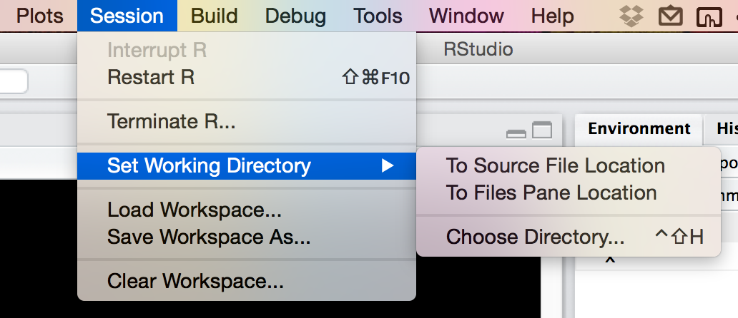
Working Directory
How to set the working directory:
setwd(“PATH”)
If you aren’t really familiar or good with using PATH values, here’s a trick:

Slide 37
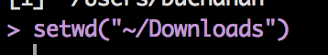
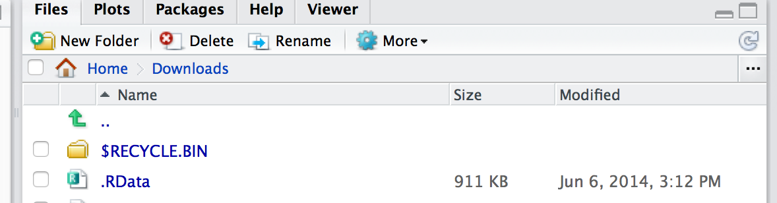
Working Directory
Now you can pick the folder you are interested in saving your files to.
Once you do that, the bottom right window will show you that folder.

Slide 38
Working Directory
Why is all this important?
You can use getwd and setwd in saved R scripts to point the analyses to specific files.
Basically, you can set it to import a file from a specific spot and use that over and over, rather than importing the file each time you open R.

Slide 39
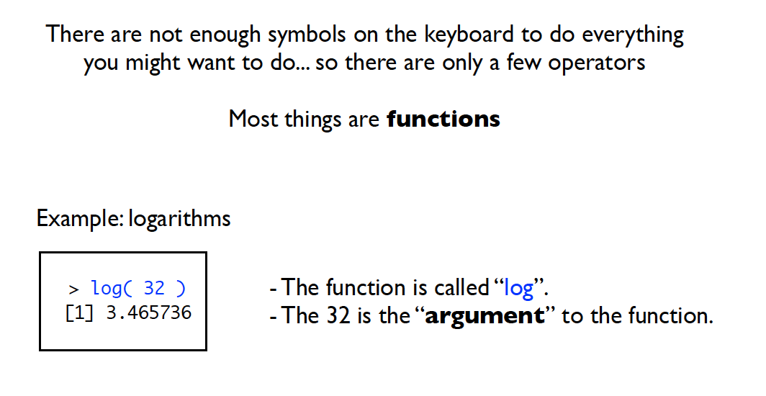
Functions

Slide 40
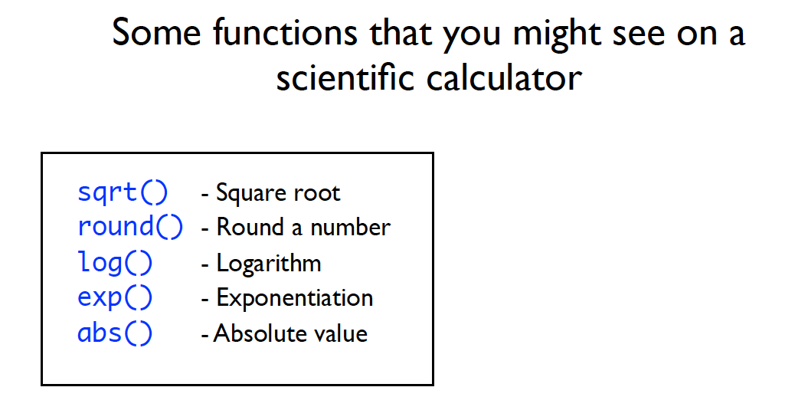
Functions

Slide 41
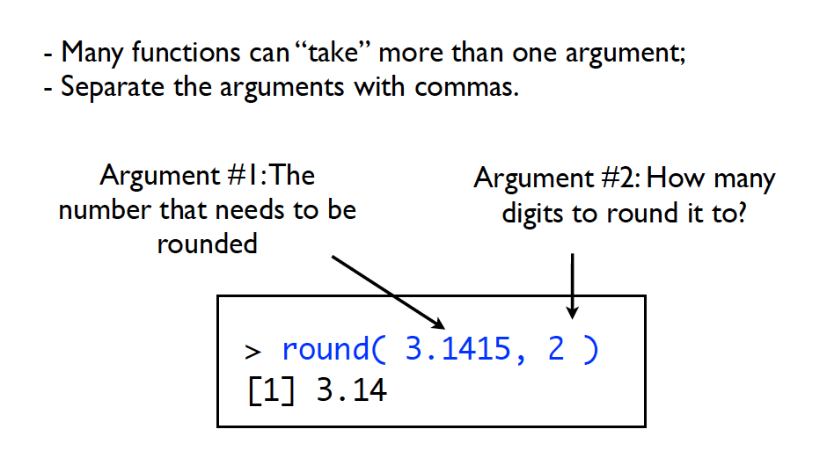
Functions

Slide 42
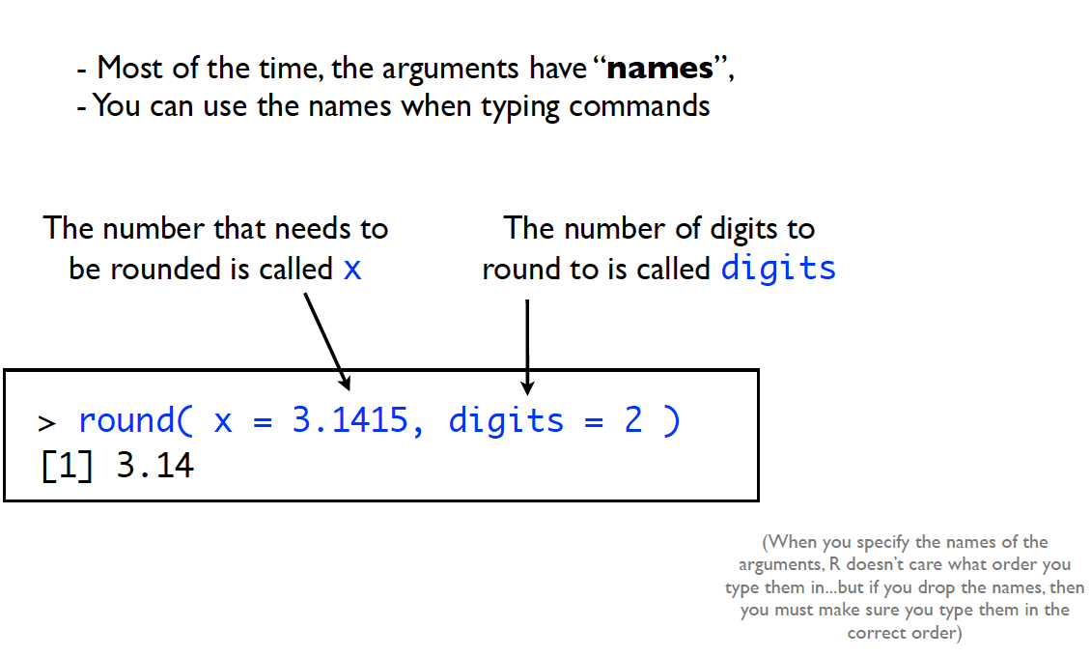
Functions

Slide 43
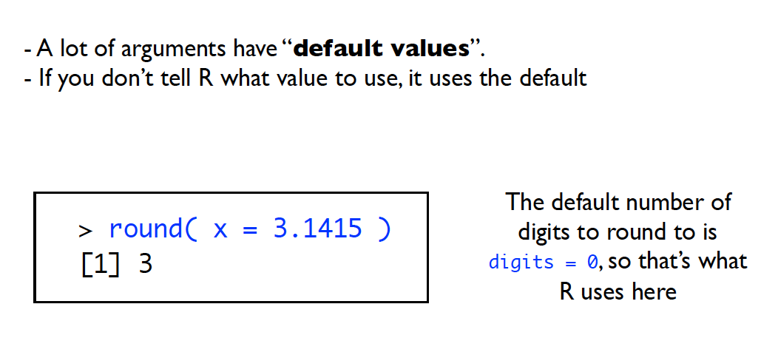
Functions

Slide 44
Variables/Objects
Variables are used to store information
They are more formally called objects.
They give you a way to label information
Use the “assignment” operator to create them
You can use = OR <-
I use = that’s much easier, but you’ll see <- a lot of places.

Slide 45
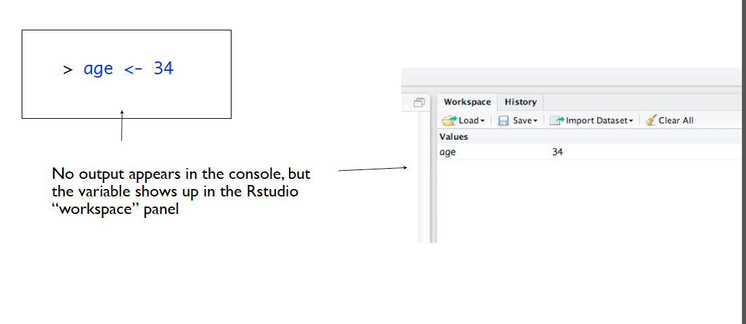
Variables/Objects
Anytime you create/use a variable, it will appear in the environment window.

Slide 46
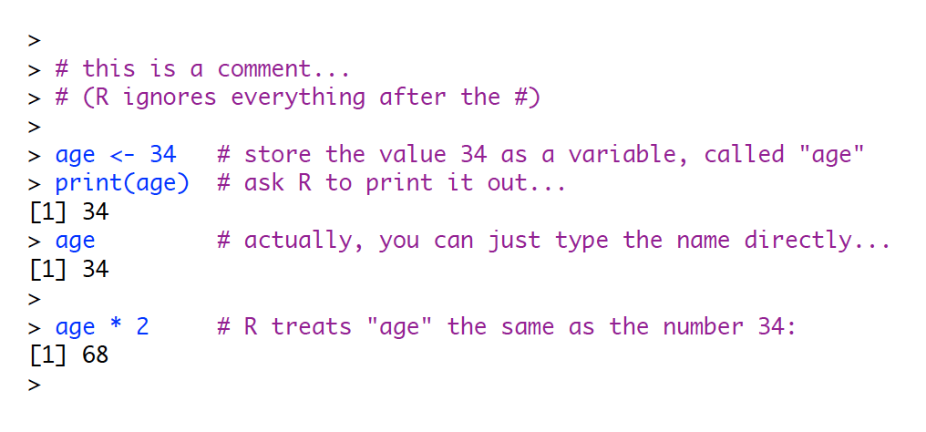
Variables/Objects

Slide 47
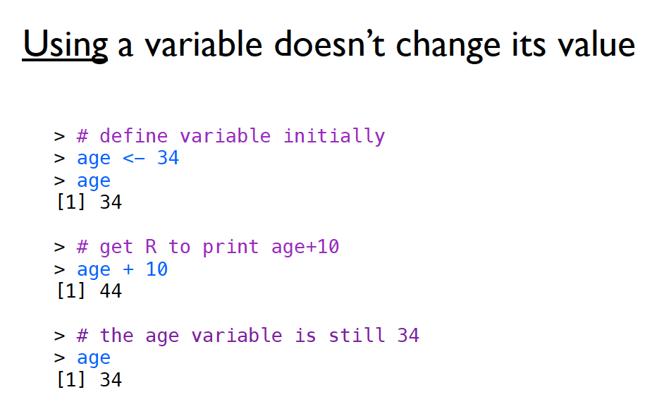
Variables/Objects

Slide 48
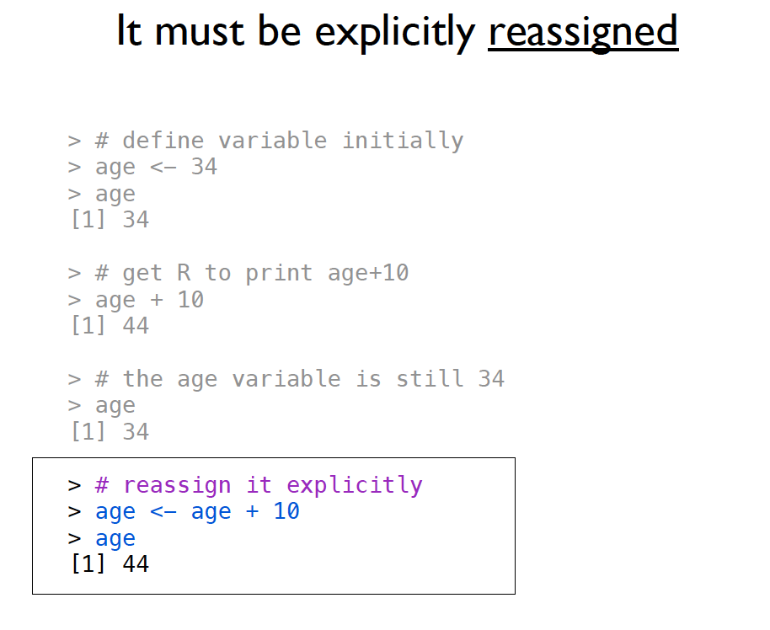
Variables/Objects

Slide 49
Variables/Objects
The environment window also allows you to see all the types of the variables you have open.
I find this very handy for lists and dataframes, which can be difficult to remember what all is stored in them.

Slide 50
Object Types
Vectors
Lists
Matrices
Data Frames

Slide 51
Object Types
Within these objects, values can be:
Character
Numeric/Integer/Complex
Logical
NaN (versus NA)

Slide 52
Object Types
And furthermore, within objects you can have attributes
The most important that you’ll use are their names
Example:
After you run a regression, you can get a variable that has the residuals and coefficients stored. They are stored with specific names, so you can call them.

Slide 53
Object Types
Another way to see what’s going on with an object:
ls(OBJECT NAME)
LS gives you a list of the names in an object.
str(OBJECT NAME)
STR gives you the structure of an object, which is helpful to know what things are stored in that object.
It’s the same thing you can see in the environment window.

Slide 54
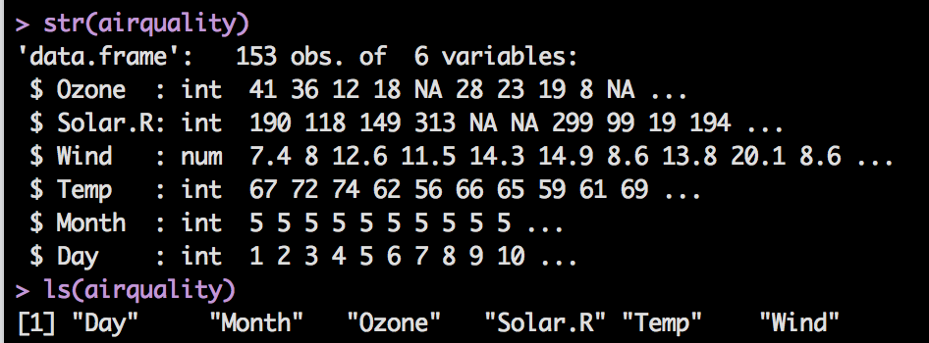
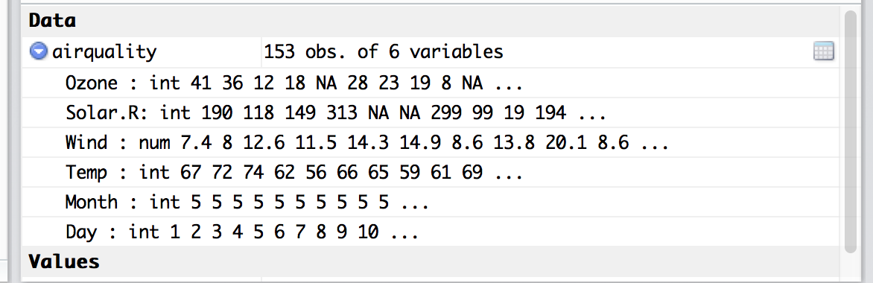
Object Types

Slide 55
Vectors
You can think about a vector as one row or column of data
All the objects must be the same class/type (number, logical, etc.).
If you try to mix and match, it will coerce them into the same type or make them NA if not.

Slide 56
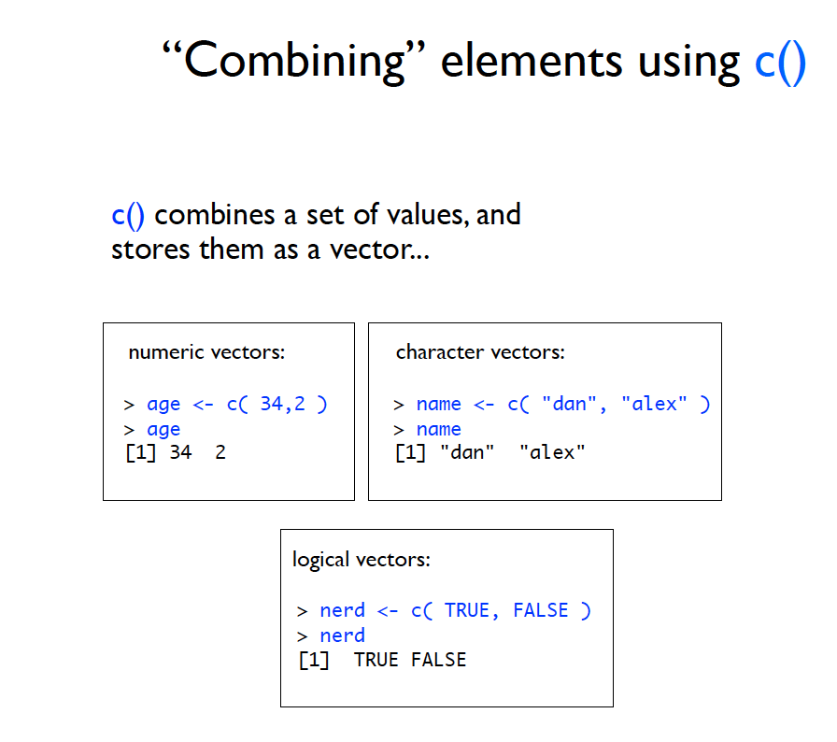
Vectors

Slide 57
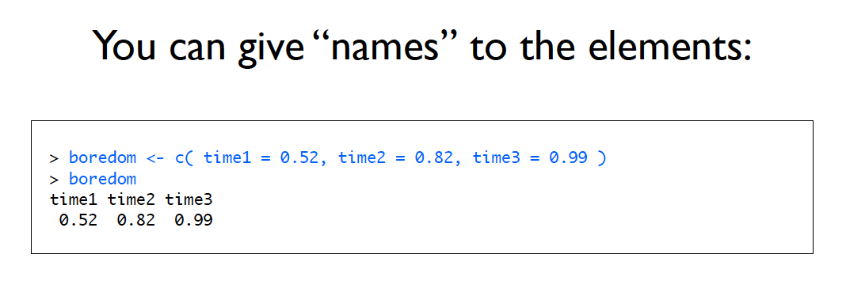
Vectors

Slide 58
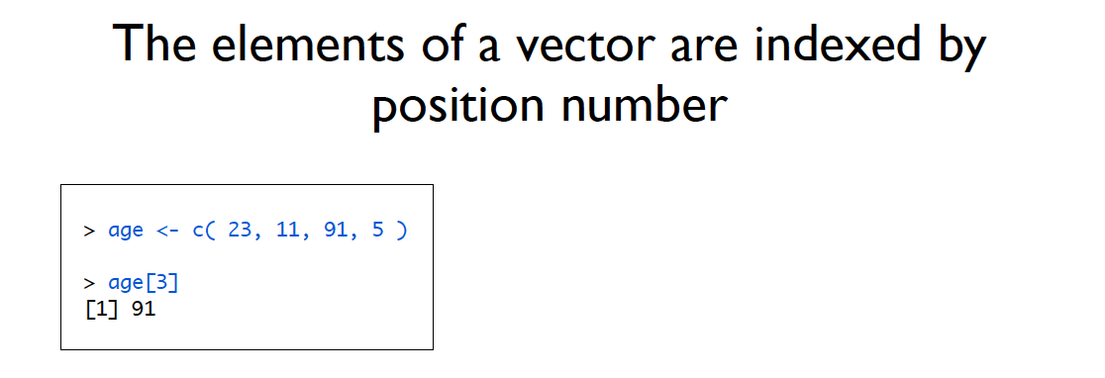
Vectors

Slide 59
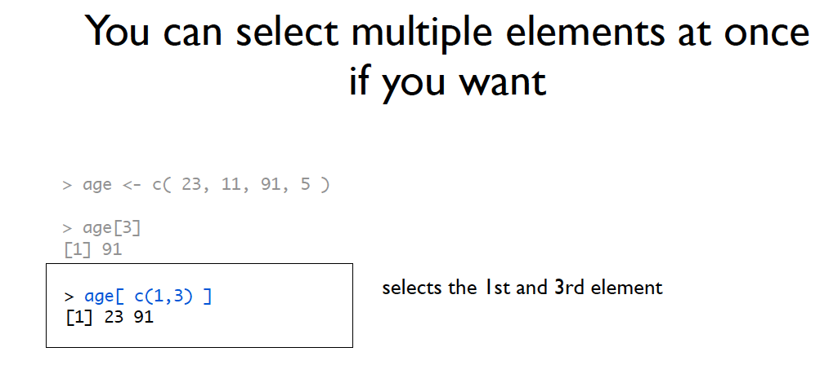
Vectors

Slide 60
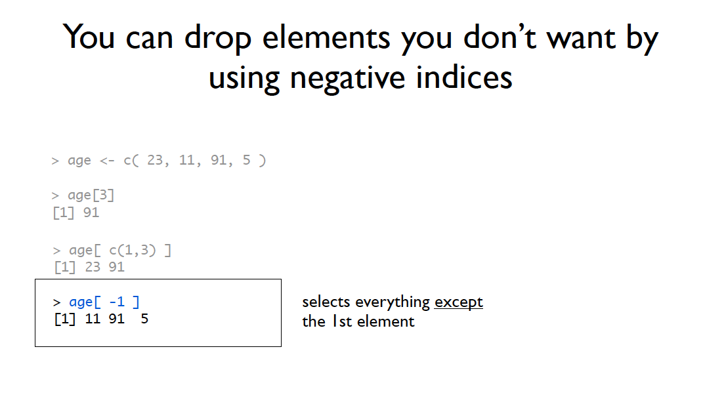
Vectors

Slide 61
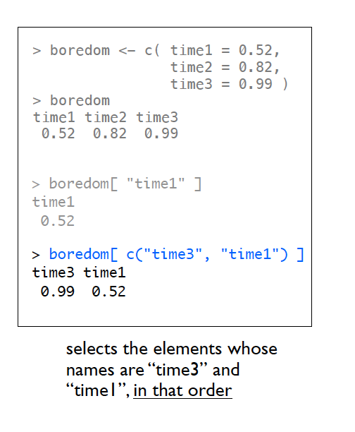
Vectors
You can also index by name

Slide 62
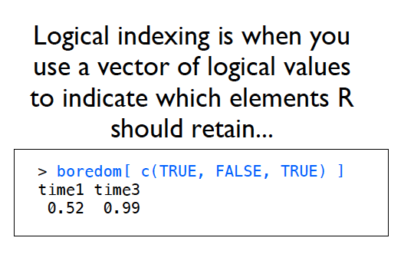
Vectors
Or logically:

Slide 63
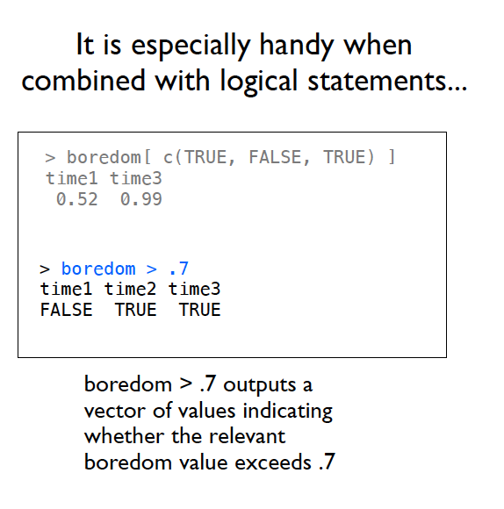
Vectors
Or logically:

Slide 64
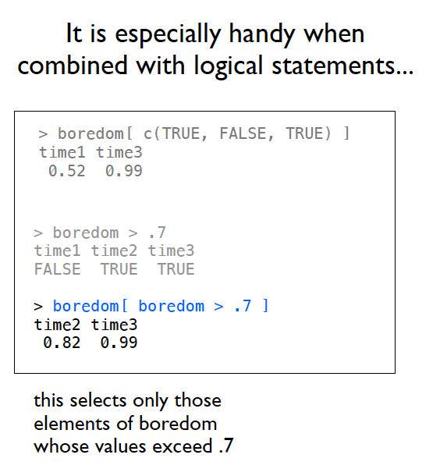
Vectors
Or logically:

Slide 65
Data frames
Data Frames are your friend
We will use these the most often.
They are special matrices, where everything must be the same length.
BUT the columns can be different classes.
So you can have characters, logicals, and numbers all together.

Slide 66
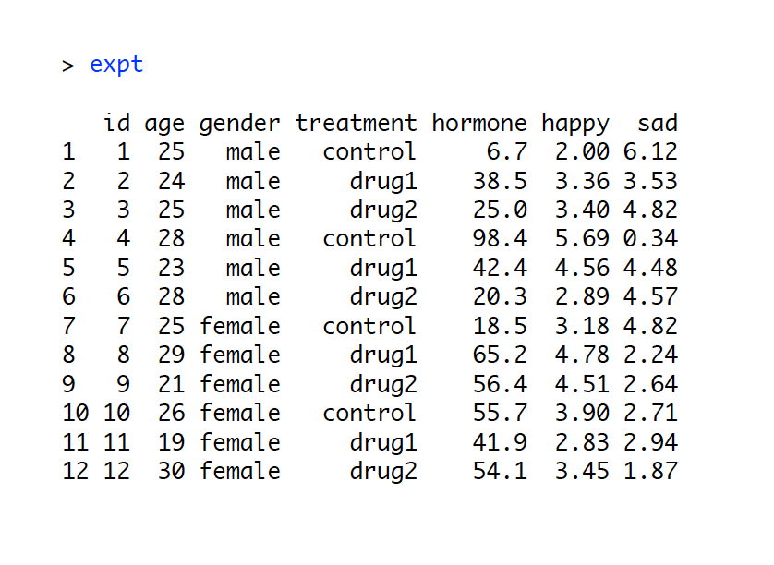
Data frames

Slide 67
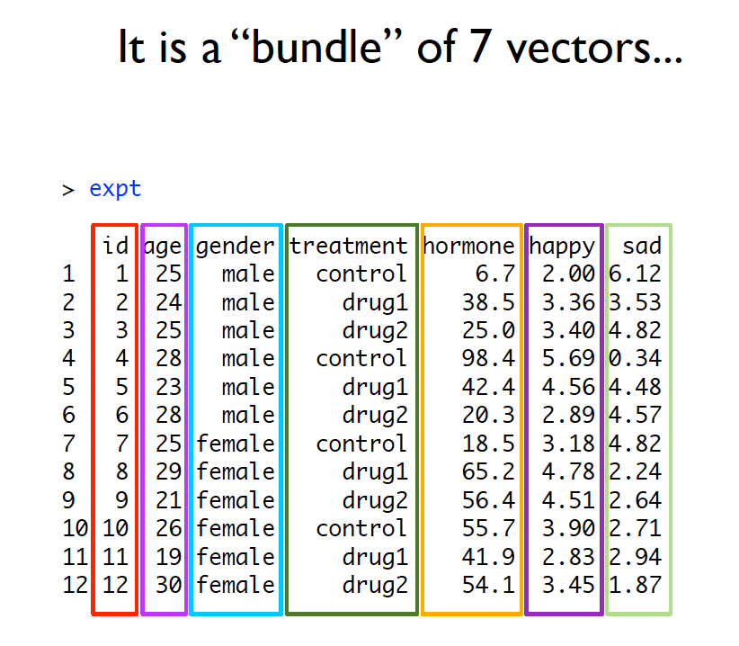
Data frames

Slide 68
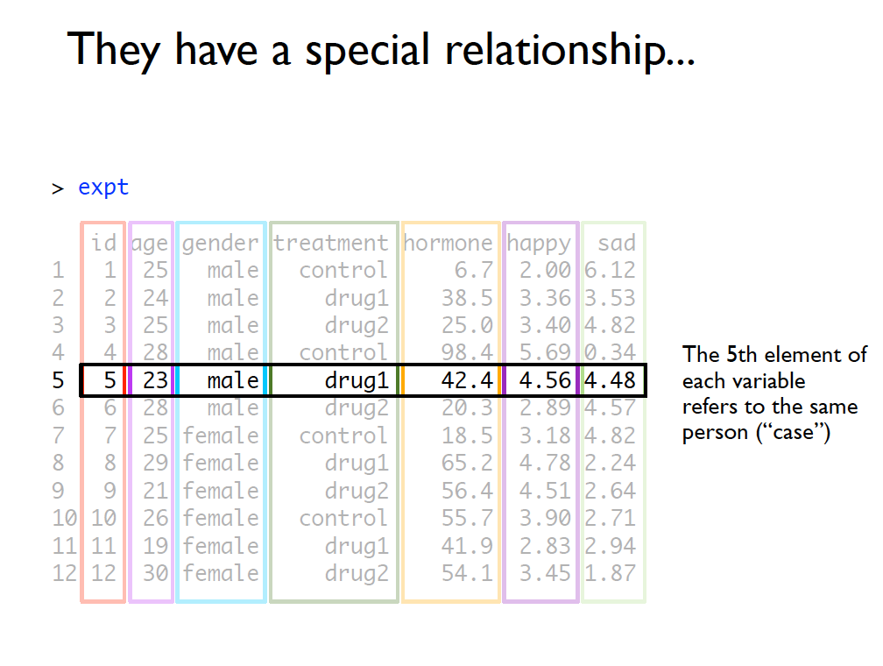
Data frames

Slide 69
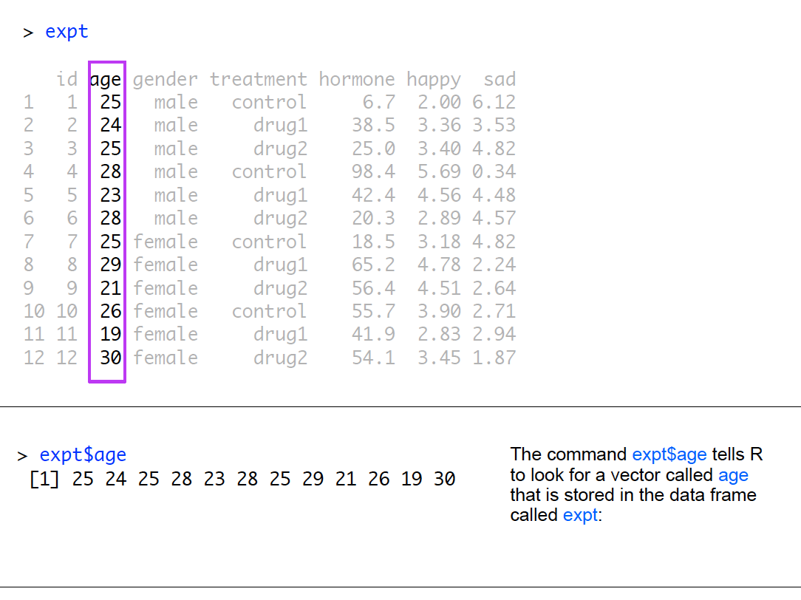
Data frames

Slide 70
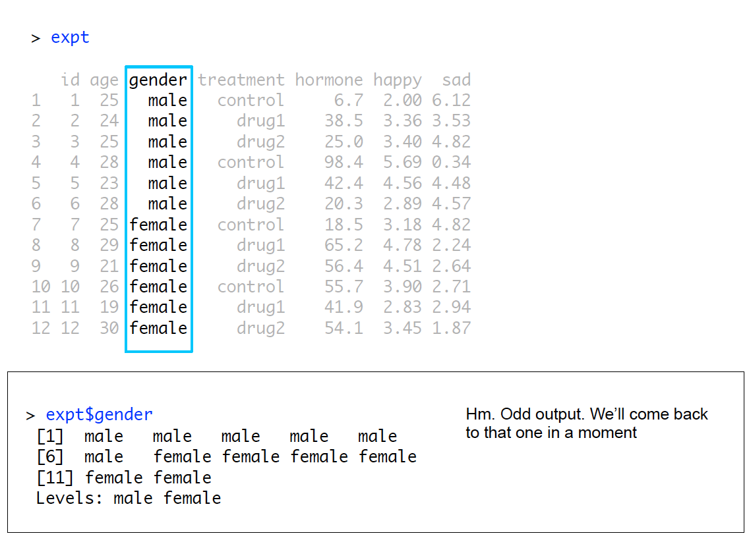

Slide 71
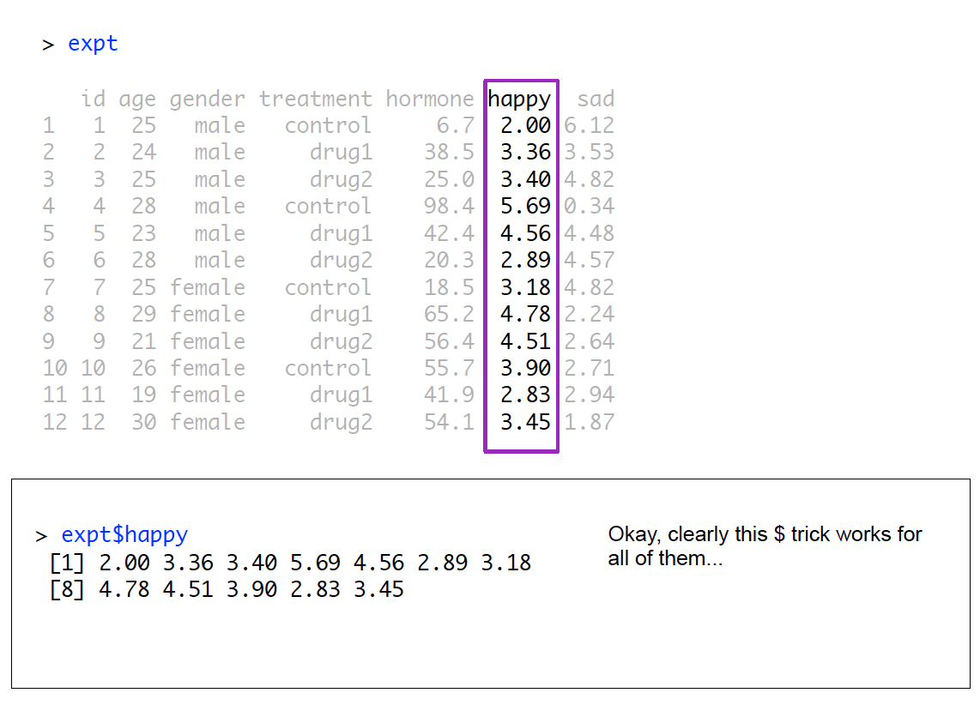

Slide 72
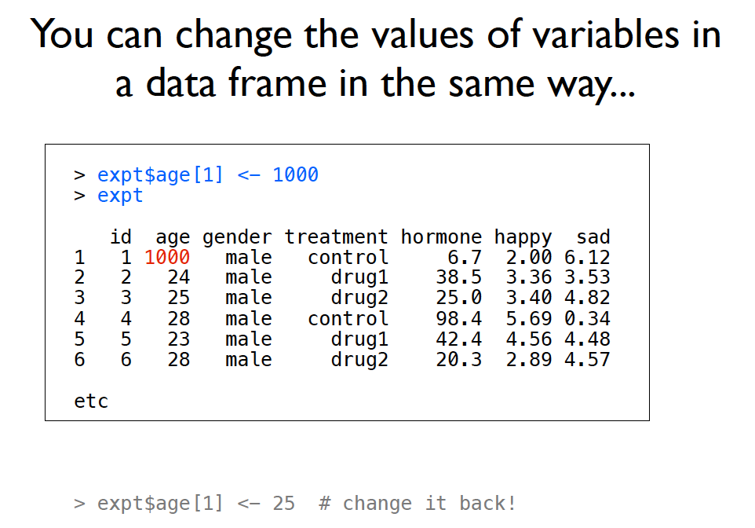
Data frames

Slide 73
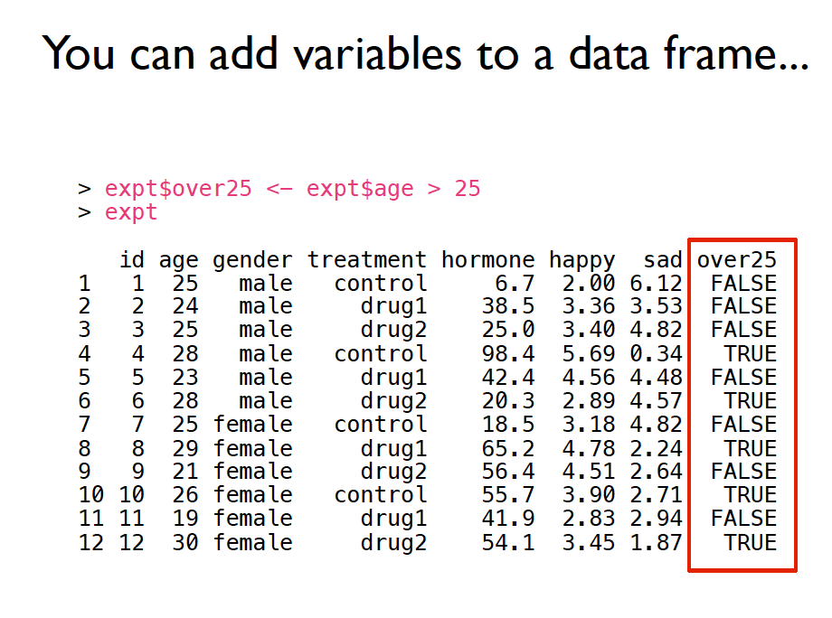
Data frames

Slide 74

Data frames

Slide 75



Data frames

Slide 76

Data frames

Slide 77

Data frames

Slide 78

Data frames
Subset allows you to pick specific rules to pull only those rows.

Slide 79


Slide 80
Packages
What is a package?
Packages are add-ons to R that allow you to do different types of analyses, rather than code them yourself.
R comes with many pre-programming functions – lovingly called base R.

Slide 81

Packages

Slide 82
Packages
Installed means:
That the package files are stored on your computer
Must be connected to the internet
Your version of R is able to load the package

Slide 83
Packages
Loaded means:
That R has opened the package files
You can use the functions / data stored in that package.

Slide 84
Packages
Why?!
5000+ packages means that different authors will use the same “name” to refer to different functions!
If every installed package were also loaded, it would introduce a lot of naming conflicts

Slide 85

Packages

Slide 86


Slide 87


Slide 88


Slide 89


Slide 90

Packages
Packages are also called libraries.
You can load them two ways:
In the console: library(car) (look no “” this time).
In the packages window by clicking on the check box.

Slide 91
Packages
I suggest adding the code to your script to load the packages you need to save yourself the headache of trying to remember which ones were important.

Slide 92

Working with files

Slide 93

Working with files

Slide 94

Working with files

Slide 95

Working with files

Slide 96

Working with files

Slide 97


Slide 98


Slide 99


Slide 100


Slide 101

Working with files
Aka things to cut and paste into your script!

